Slide 1
MongoDB
MongoDB CRUD Operations
(version 4.4.1)

Slide 2
MongoDB CRUD Operations
Create/Insert Documents
Read/Query Documents
Update Documents
Delete Documents

Slide 3
Create Operations
db.collection.insertOne() (since version 3.2)
db.collection.insertMany() (since version 3.2)
db.collection.insert()

Slide 4
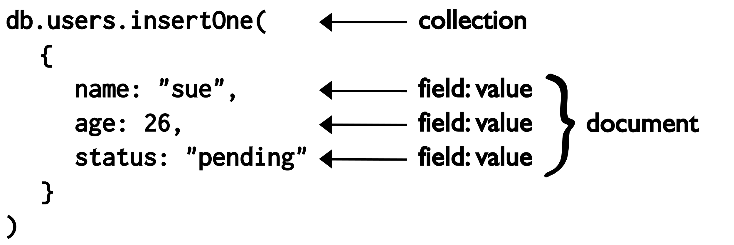
Create Operations – insertOne()

Slide 5
Create Operations – insertOne()
db.collection.insertOne( { field : ‘value’ } );

Slide 6
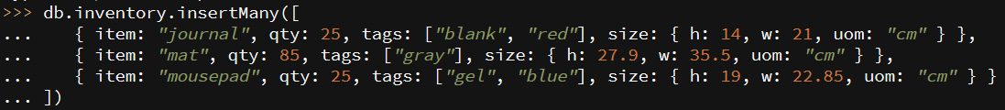
Create Operations – insertMany()
db.collection.insertMany( { field : ‘value’ }, { … }, … );

Slide 7
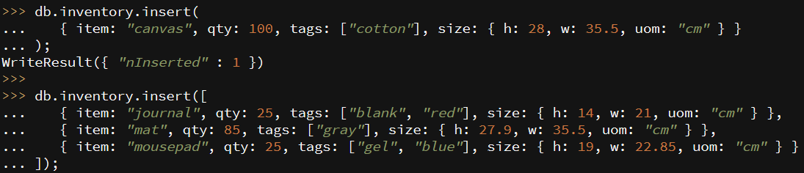
Create Operations – insert()
Insert one document
Insert multiple documents

Slide 8

Create Operations – insert(document)
Define a document
Insert a document

Slide 9
.save() ???

Slide 10
Query Operations
db.collection.find();
db.collection.find().pretty();
db.collection.findOne();
db.collection.find( { field : ‘value’; } );

Slide 11
Query Operations – find() without condition
db.collection.find();
db.collection.find({ });

Slide 12
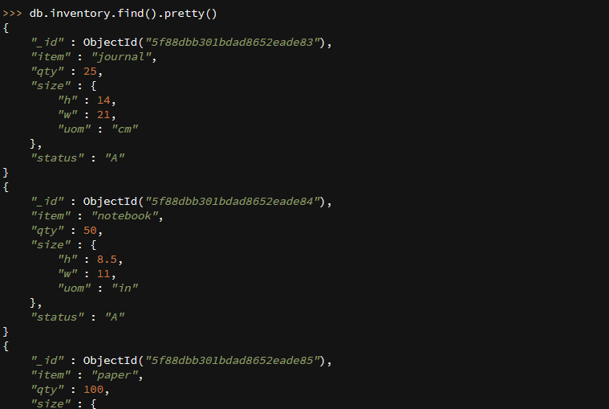
Query Operations – find() without condition
db.collection.find().pretty();

Slide 13
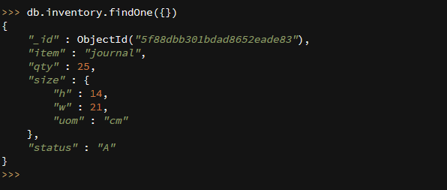
Query Operations – find() without condition
db.collection.findOne();

Slide 14
Query Operations – find() with conditions
db.collection.find( { field : ‘value’ } );
Find() with one condition
Find() with AND, OR

Slide 15
Update Operation
db.collection.updateOne();
db.collection.updateMany();
db.collection.replaceOne();
db.collection.update();

Slide 16

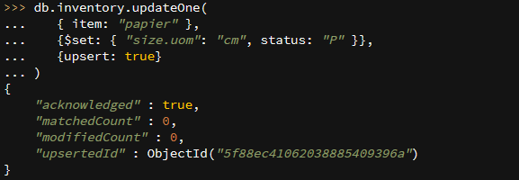
Update Operation -- updateOne
db.collection.updateOne( {filter}, {update}, {options} );
Options: {upsert: boolean} --- default: false

Slide 17

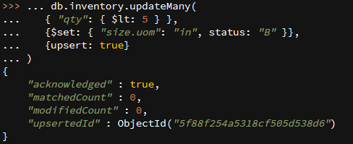
Update Operation -- updateMany()
db.collection.updateMany();
Options: {upsert: boolean} --- default: false

Slide 18

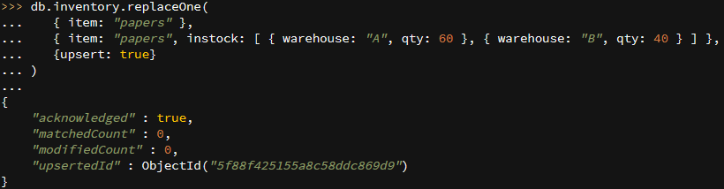
Update Operation -- replaceOne()
db.collection.replaceOne();
Options: {upsert: boolean} --- default: false

Slide 19
Update Operation -- update()
db.collection.update( {filter}, {update}, {options} );
db.inventory.update(
{ item: “envelop" },
{ item: “ envelop ", instock: [ { warehouse: "A", qty: 60 }, { warehouse: "B", qty: 40 } ] },
{upsert: true}
)
upsert – default value: false
db.inventory.update(
{ qty: 25 },
{$set: { "size.uom": “mm”, status: “B” }},
{multi: true}
)
multi – default value: false

Slide 20
Insert or Update with .save()?
db.collection.save()
Filter with an existing _id
update()
Filter without an existing _id
insert() with upsert:true

Slide 21
Delete Operations
db.inventory.deleteOne( { status: "D" } );
Delete one document
db.inventory.deleteMany({ status : "A" });
Delete multiple documents
db.inventory.deleteMany({ });
Delete all documents

Slide 22
Delete Operations
db.document.remove()
db.inventory.remove( {qty: 25 } );
db.inventory.remove( {qty: 25 }, {justOne: true} );
db.inventory.remove( {qty: 25 }, {justOne: 1} );
justOne -- default value: false
Delete all documents
db.inventory.remove({ });

Slide 23
References
MongoDB MANUAL:
https://docs.mongodb.com/manual/crud/

